Slide 1
Charles City County public schools Strategic performance monitoring
Charles City County Public Schools committed to monitoring of the implementation of their five-year strategic plan. The plan, comprised of three pillars, has 22 performance measures that by the end of the 2023 will inform the Division on its implementation.
Year 1: 2018-2019
October 15, 2019
Prepared by

Slide 2
Table of Contents
Introduction
1
2
3
4
Slides 3 - 4
Educate
Engage
Empower
Next Steps
PM 1
PM 3
PM 4
PM 5
PM 8
PM 9
PM 10
PM 11
PM 13
PM 14
PM 15
PM 17
PM 18
PM 19
PM 20
PM 21
Status Updates for 6 Performance Measures: Not Reported in SY 2018-19
PM 2
PM 6
PM 7
PM 12
PM 16
PM 22

Slide 3
SEG Reviewed the Data to Discern Progress and Identify Needs Related to the Three Pillars
The 2018-2023 CCPS Strategic Plan envisions the school system’s future and articulates means to measure progress on the three pillars of educate, engage, and empower that define its stakeholders’ work and outcomes.
Charles City County Public Schools contracted with Shaffer Evaluation Group (SEG) to assess their performance during the Strategic Plan’s implementation.
SEG worked with the division and the strategic plan consultant to identify performance measures aligned to the three pillars. SEG identified common data sources connected with each of the 22 performance measures.
The Educate pillar is the primary function of the school system, and 15 of the performance measures are associated with it. The remaining 7 are distributed between the Engage Pillar and the Empower Pillar.
The process of collecting, reviewing, and submitting baseline data (2017-2018) and the Year 1 implementation data (2018-2019) of the Charles City County Strategic Plan revealed
opportunities to improve data management and reflection. Since data was not available for six performance measures, baseline data must continue to be established in 2019-2020.
The Year 1 report organizes the data by the three strategic “pillars” of Educate, Engage, and Empower.

Slide 4
Performance Measure Data Presentation
Text written in orange highlights a specific piece of information related to the page.
Every graphic and chart on the page is purposeful. For example, the pillar graphic in the lower left-hand corner provides a visual reference to which pillar the data is reporting upon through the use of a colored rectangle. The colors were selected from the Charles City County Public Schools logo and align to the table of contents. The color for each pillar appears in parentheses Educate (blue), Engage (orange), and Empower (green). Data is presented visually to communicate the analysis when possible .
The organization of the individual performance measure pages is unique to that data set. In most cases, a performance measure is presented on a single page; however, if the data requires additional explanation or needs more space, it is provided. In these cases, the gray footer information may not be repeated. All pillars have data sources to support reflection on the Year 1 Strategic Plan implementation; however, not all performance measures were collected in Year 1. Those performance measures are presented at the end of the report with their current status.
The report text contains four levels of detail. Reading the titles on the page provides a basic overview, the orange text offers the highlights, while this smaller blue text offers additional detail about the data presented and may include recommendations. If text appears in green, it is providing a definition. The final level is the smallest text on the page and provides reference information to the text of the performance measure and the source of the data.
The pillar is named and the performance measure is written in this space. The graphic (lower left) has a color-coded rectangle placed in the applicable pillar for the performance measure. | The “Data Source Information” is presented here. Many of the data sources came from CCPS Central Office and/or school records. Examples include but are not limited to: de-identified STAR test data, yearbooks, and rosters. External data sources are also used: Virginia Quality Reports, social media statistics, and the Panorama (vendor contracted by CCPS) survey reports. Where possible, SEG analyzed and verified the raw data.
1

Slide 5
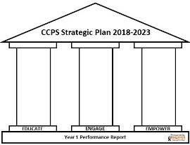
Educate
Provide a rigorous and meaningful educational experience that results in post-secondary skills valuable in academic pursuits and in the workplace.

Slide 6
Students Enrolled in Flexible Learning Opportunities Increased By 10-Percentage Points
A variety of online courses were available for students in grades 9-12. These courses include but are not limited, to three levels of Spanish, English 9-12, Mathematical Analysis, Virginia and US Government, Strategies for Academic Success, Marketing, Introduction to Art, and Personal Finance. The most popular course taken online was Mathematical Analysis with enrollment totaling 12 students in Year 1.
Baseline data provided by CCPS Central Office included students enrolled in flexible learning opportunities in grades 9-12 classes. Data from 2018-2019 school year indicated that middle school students also had the opportunity to enroll in flexible learning opportunities (e.g., English 7, Math 8). To align to the baseline data, only high school courses were included in the analysis.
Educate Pillar Performance Measure 1: The percentage of students enrolled in flexible learning opportunities through virtual and distance course offerings. | Data Source Information: CCPS Central Office provided data for the baseline and the 2018-2019 school year. Baseline data was provided and unverified by SEG. 2018-2019 data was provided in Excel and verified by SEG.
1

Slide 7
SOL Assessment Performance Improves in 3 Content Areas
History
Math
Reading
The following nine slides present information from the Virginia School Quality Reports for Charles City’s indicators for 2017-2018 (Baseline) and 2018-2019 (Year 1). For each core content area a pair of slides are presented. Both slides include the subgroup data. The first slide contains the division level “all students” data, and the second slide presents the school level data. The final slide reports on the federal graduation indicator.
Performance Measure 3 focuses on a comparison between the state average and Charles City County Public Schools. It is noteworthy that percentage of students earning pass proficient or pass advanced designations on the Virginia SOL increased over the CCPS baseline data in three content areas.
Baseline
Science
Educate Pillar Performance Measure 3: The division and schools exceeding the average for all students, and subgroups, in mathematics, English, history/social science, science and the federal graduation index. | Data Source Information: Virginia Department of Education School Quality Profile. Data indicate the percentage of students scoring proficient on Virginia Standard of Learning Assessments (SOL). A score of proficient is 400 or above.

Slide 8
Reading Performance Improved Overall
In 2018-2019, Asian, Black, and Hispanic subgroups scored above the state passing percentage. In 2018-2019 the largest gains were made by students in Black subgroups (2 percentage-points) and the White subgroup (12 percentage-points) .
Reading Performance Across Subgroups
 | Baseline 2017-2018 |  | 2018-2019
 | Division | State | Division | State
Asian | * | 90 | 100 | 89
Black | 67 | 67 | 69 | 65
Hispanic | 66 | 67 | 100 | 66
White | 67 | 86 | 79 | 85
Two or more races | 83 | 83 | 68 | 81
Students with disabilities | 24 | 48 | 35 | 47
Economically Disadvantaged | 66 | 66 | 70 | 65
English Learners | * | 36 | * | 35
NOTE: that * denotes not enough available student data to calculate a percentage.
Green shading indicates the division exceeds the state average.
Red shading indicates that the division did not exceed the state average
Educate Pillar Performance Measure 3: The division and schools exceeding the average for all students, and subgroups, in mathematics, English, history/social science, science and the federal graduation index. | Data Source Information: Virginia Department of Education School Quality Profile. Data indicate the percentage of students scoring proficient on Virginia Standard of Learning Assessments (SOL). A score of proficient is 400 or above.
3

Slide 9
Reading Performance
Charles City Elementary School | Baseline 2017-2018 |  | 2018-2019
 | ES | State | ES | State
Asian | * | 90 | * | 89
Black | 68 | 67 | 68 | 65
Hispanic | * | 67 | * | 66
White | 70 | 86 | 80 | 85
Two or more races | * | 83 | 70 | 81
Students with disabilities | 28 | 48 | 41 | 47
Economically Disadvantaged | 68 | 66 | 69 | 65
English Learners | * | 36 | * | 35
Charles City Elementary students in the Black and economically disadvantaged subgroups scored above the state average. White, two or more races, and students with disabilities scored below the state average. Charles City High School students in the Asian, Black, Hispanic, and economically disadvantaged subgroups scored above the state average. White and students with disabilities subgroups scored below the state average.
Charles City High School | Baseline 2017-2018 |  | 2018-2019
 | HS | State | HS | State
Asian | * | 90 | 100 | 89
Black | 66 | 67 | 70 | 65
Hispanic | 100 | 67 | 100 | 66
White | 63 | 86 | 78 | 85
Two or more races | * | 83 | * | 81
Students with disabilities | 19 | 48 | 27 | 47
Economically Disadvantaged | 63 | 66 | 71 | 65
English Learners | * | 36 | * | 35
NOTE: that * denotes not enough available student data to calculate a percentage.
Green shading indicates the division exceeds the state average.
Red shading indicates that the division did not exceed the state average
Educate Pillar Performance Measure 3: The division and schools exceeding the average for all students, and subgroups, in mathematics, English, history/social science, science and the federal graduation index. | Data Source Information: Virginia Department of Education School Quality Profile. Data indicate the percentage of students scoring proficient on Virginia Standard of Learning Assessments (SOL). A score of proficient is 400 or above.

Slide 10
Math Performance Improved Overall
While no single subgroup in mathematics exceeded the state average, most subgroups increased the percentage of students passing the SOL when compared to the Division baseline.
Math Performance Across Subgroups
 | Baseline 2017-2018 |  | 2018-2019
 | Division | State | Division | State
Asian | * | 92 | * | 94
Black | 44 | 64 | 62 | 70
Hispanic | 100 | 68 | * | 74
White | 58 | 84 | 75 | 88
Two or more races | 71 | 80 | 65 | 85
Students with disabilities | 23 | 47 | 31 | 55
Economically disadvantaged | 44 | 66 | 62 | 72
English Learners | * | 49 | * | 59
NOTE: that * denotes not enough available student data to calculate a percentage.
Red shading indicates that the division’s Year 1 average did not exceed the state average.
Educate Pillar Performance Measure 3: The division and schools exceeding the average for all students, and subgroups, in mathematics, English, history/social science, science and the federal graduation index. | Data Source Information: Virginia Department of Education School Quality Profile. Data indicate the percentage of students scoring proficient on Virginia Standard of Learning Assessments (SOL). A score of proficient is 400 or above.
3

Slide 11
Math Performance
Charles City Elementary School | Baseline 2017-2018 |  | 2018-2019
 | ES | State | ES | State
Asian | * | 92 | * | 94
Black | 59 | 64 | 69 | 70
Hispanic | * | 68 | * | 74
White | 67 | 84 | 81 | 58
Two or more races | * | 80 | 60 | 85
Students with disabilities | 32 | 47 | 45 | 55
Economically Disadvantaged | 59 | 66 | 68 | 72
English Learners | * | 49 | * | 59
In the elementary and high schools, students in White subgroup scored above the state average. All other subgroups at both schools scored below the state average; however, in most cases, the 2018-19 score was above the baseline score for the Division.
Charles City High School | Baseline 2017-2018 |  | 2018-2019
 | HS | State | HS | State
Asian | * | 91 | * | 94
Black | 34 | 64 | 57 | 70
Hispanic | 100 | 68 | * | 74
White | 52 | 84 | 70 | 58
Two or more races | * | 80 | 70 | 85
Students with disabilities | 18 | 47 | 17 | 55
Economically Disadvantaged | 30 | 66 | 56 | 72
English Learners | * | 49 | * | 59
NOTE: that * denotes not enough available student data to calculate a percentage.
Green shading indicates the division exceeds the state average.
Red shading indicates that the division did not exceed the state average
Educate Pillar Performance Measure 3: The division and schools exceeding the average for all students, and subgroups, in mathematics, English, history/social science, science and the federal graduation index. | Data Source Information: Virginia Department of Education School Quality Profile. Data indicate the percentage of students scoring proficient on Virginia Standard of Learning Assessments (SOL). A score of proficient is 400 or above.

Slide 12
Science Performance Declined Overall
In 2018-2019, Hispanic students scored above the state pass percentage. Students with disabilities performed better on the division average in 2018—19 than they did in 2017-2018. English language learners in CCPS continued to exceed the state average.
Science Performance Across Subgroups
 | Baseline 2017-2018 |  | 2018-2019
 | Division | State | Division | State
Asian | * | 92 | * | 93
Black | 73 | 67 | 65 | 67
Hispanic | 100 | 79 | 100 | 79
White | 84 | 89 | 79 | 89
Two or more races | 100 | 85 | * | 84
Students with disabilities | 36 | 50 | 41 | 51
Economically disadvantaged | 73 | 69 | 63 | 68
English Learners | 100 | 36 | 100 | 38
NOTE: that * denotes not enough available student data to calculate a percentage.
Green shading indicates the division exceeds the state average.
Red shading indicates that the division’s Year 1 average did not exceed the state average.
Educate Pillar Performance Measure 3: The division and schools exceeding the average for all students, and subgroups, in mathematics, English, history/social science, science and the federal graduation index. | Data Source Information: Virginia Department of Education School Quality Profile. Data indicate the percentage of students scoring proficient on Virginia Standard of Learning Assessments (SOL). A score of proficient is 400 or above.
3

Slide 13
Science Performance
Charles City Elementary School | Baseline 2017-2018 |  | 2018-2019
 | ES | State | ES | State
Asian | * | 92 | * | 93
Black | 61 | 67 | 48 | 67
Hispanic | * | 79 | * | 79
White | 94 | 89 | * | 89
Two or more races | * | 85 | * | 84
Students with disabilities | * | 50 | * | 51
Economically Disadvantaged | 68 | 69 | 36 | 68
English Learners | * | 36 | * | 38
At the elementary school, all subgroups scored on average below the state average. Further, most subgroups lacked a sufficient number of students passing the SOL for the state to calculate a school average.
The high school White and students with disabilities subgroups scored on average below the state average.
Charles City High School | Baseline 2017-2018 |  | 2018-2019
 | HS | State | HS | State
Asian | * | 92 | * | 93
Black | 75 | 67 | 69 | 67
Hispanic | 100 | 79 | 100 | 79
White | 83 | 89 | 82 | 89
Two or more races | 100 | 85 | * | 84
Students with disabilities | 30 | 50 | 41 | 51
Economically Disadvantaged | 74 | 69 | 69 | 68
English Learners | 100 | 36 | 100 | 38
In the high school, students in the Black, Hispanic, economically disadvantaged, and English learner subgroups scored on average above the state average.
NOTE: that * denotes not enough available student data to calculate a percentage.
Green shading indicates the division exceeds the state average.
Red shading indicates that the division did not exceed the state average
Educate Pillar Performance Measure 3: The division and schools exceeding the average for all students, and subgroups, in mathematics, English, history/social science, science and the federal graduation index. | Data Source Information: Virginia Department of Education School Quality Profile. Data indicate the percentage of students scoring proficient on Virginia Standard of Learning Assessments (SOL). A score of proficient is 400 or above.

Slide 14
History Performance Increased Overall
All student subgroups performed better in 2018-2019 than in the previous year. Most student subgroups exceeded the state average for History Performance. As the next slide will show, at the school level these increases were made at the secondary level, not the elementary level.
History Performance Across Subgroups
 | Baseline 2017-2018 |  | 2018-2019
 | Division | State | Division | State
Asian | * | 95 | * | 93
Black | 66 | 72 | 77 | 66
Hispanic | 100 | 77 | 100 | 72
White | 68 | 90 | 81 | 87
Two or more races | * | 87 | 83 | 83
Students with disabilities | 30 | 57 | 54 | 52
Economically disadvantaged | 65 | 73 | 74 | 68
English Learners | 100 | 52 | 100 | 47
NOTE: that * denotes not enough available student data to calculate a percentage.
Green shading indicates the division exceeds the state average.
Red shading indicates that the division’s Year 1 average did not exceed the state average.
Educate Pillar Performance Measure 3: The division and schools exceeding the average for all students, and subgroups, in mathematics, English, history/social science, science and the federal graduation index. | Data Source Information: Virginia Department of Education School Quality Profile. Data indicate the percentage of students scoring proficient on Virginia Standard of Learning Assessments (SOL). A score of proficient is 400 or above.
3

Slide 15
History Performance
Charles City Elementary School | Baseline 2017-2018 |  | 2018-2019
 | ES | State | ES | State
Asian | * | 95 | * | 93
Black | 59 | 72 | 63 | 66
Hispanic | * | 77 | * | 72
White | 80 | 90 | 69 | 87
Two or more races | * | 87 | * | 83
Students with disabilities | * | 57 | 36 | 52
Economically Disadvantaged | 56 | 73 | 60 | 68
English Learners | * | 52 | * | 47
All subgroups at Charles City Elementary School scored on average below the state average. Charles City High School students in Black, Hispanic, economically disadvantaged, economically disadvantaged, and English learner subgroups scored on average above the state average.
Charles City High School | Baseline 2017-2018 |  | 2018-2019
 | HS | State | HS | State
Asian | * | 95 | * | 93
Black | 68 | 72 | 79 | 66
Hispanic | 100 | 77 | 100 | 72
White | 67 | 90 | 85 | 87
Two or more races | 100 | 87 | * | 83
Students with disabilities | 23 | 57 | 62 | 52
Economically Disadvantaged | 67 | 73 | 78 | 68
English Learners | 100 | 52 | 100 | 47
NOTE: that * denotes not enough available student data to calculate a percentage.
Green shading indicates the division exceeds the state average.
Red shading indicates that the division did not exceed the state average
Educate Pillar Performance Measure 3: The division and schools exceeding the average for all students, and subgroups, in mathematics, English, history/social science, science and the federal graduation index. | Data Source Information: Virginia Department of Education School Quality Profile. Data indicate the percentage of students scoring proficient on Virginia Standard of Learning Assessments (SOL). A score of proficient is 400 or above.

Slide 16
Almost 90% of CCPS Students Are Graduating Within 4 Years.
CCPS students are within 1.88 percentage-points of the state graduation average (See top graph). When analyzing student subgroups, CCPS is graduation rates fare well. The bottom graph displays subgroups with available data from 2017-2018. Black students at CCPS exceeded the state average and economically disadvantaged students were less than 1 percentage-point away from the state average. White students are 6 percentage-points away from the state graduation average.
Please note graduation rates for the 2018-2019 school year are not available on the Virginia School Quality report as of 9/30/19.
Educate Pillar Performance Measure 3: The division and schools exceeding the average for all students, and subgroups, in mathematics, English, history/social science, science and the federal graduation index. | Data Source Information: Virginia Department of Education School Quality Profile. Data includes the average percentage of students who complete high school in four years.
3

Slide 17
Greater Percentage of CCPS Third Graders Meet Reading and Math Benchmarks
Percentage of Third Grade Students Meeting Reading and Math Grade Level Benchmarks on the STAR Assessment
The STAR Reading and Mathematics assessments can be given throughout the school year. The data presented is from the end of the school year. The 2018-19 third graders outperformed the previous year’s students. There was a 15-percentage point increase from baseline in reading and an 11-percentage point increase from baseline in mathematics. The highest third grade score is >6, meaning the student can answer items associated with sixth grade and above. The range of grade level equivalent scores for the 2018-19 third graders was:
Reading: 2.6 to >6
Mathematics: 1.5 to >6
More CCPS third graders met the reading and mathematics grade level benchmarks at the end of this school year than the previous school year.
Educate Pillar Performance Measure 4: The percentage of students meeting grade level benchmarks in reading and mathematics at the close of Grade 3. | Data Source Information: CCPS Central Office provided the STAR Reading and Mathematics Assessment data. This assessment provides a grade-level equivalent (GE) score based on the time in the school year that the student takes the assessment. The grade level benchmark for a STAR assessment administered in the last month of third grade is 3.9. A student who is strong in a content area may have a GE score of 5.3 indicating the student successfully answers items associated with fifth grade students in the third month of school. Likewise, a 2.7 GE score indicates second grade, seventh month of school.
4

Slide 18
87 Students Earned CTE Credentials, An Increase from 81
2018-2019 Percentage of High School Students Earning CTE Credentials
More 2018-2019 students earned Career and Technical Education (CTE) credentials than students in the 2017-2018 baseline year. As seen in the pie chart, 46% of high school students earned a CTE credential in 2018-2019. This is a 4-percentage point increase from baseline (42% earned CTE/58% did not). The bar chart, illustrates that more students earned multiple CTE credentials than in the baseline year. The following assessments were passed by CCPS juniors and seniors. They are ordered by the number of students who passed the assessment from largest to smallest .
Workplace Readiness Skills
W!SE (Financial Literacy)
Certiport: MOS Word (tied)
Skills USA: Customer Service (tied)
Certiport: MOS Powerpoint
Skills USA: Robotics
Nurses Aide Exam
Among 18 students earning multiple CTE credentials, three credentials were most often earned. Tied at 10 students each: Skills USA: Customer Service Workplace Readiness Skills 9 students: Certiport: MOS Word
Educate Pillar Performance Measure 5: The percentage of students earning one more CTE credentials (NOCTI, state licensure, industry certification, workplace readiness). | Data Source Information: CCPS Central Office provided the Career and Technical Education assessment results for all students who passed one or more assessments. It was organized by unique student identifier number and the name of the assessment.

Slide 19
CCPS Students are Taking College-level Courses
15%
of 11th and 12th graders are enrolled in Advanced Placement (AP) or Dual Enrollment courses (2018-2019)
High school juniors and seniors are eligible to enroll in courses that may result in them earning college-credit while in high school. The majority of students who take these courses are seniors as there are prerequisite courses. The 2018-2019 data is established as the baseline data since the data facilitated analysis by individual student identifier number. Sixteen students took a total of 26 courses. Eight students took Biology II and 14 students took English 12 as dual enrollment courses. Three 12th graders and one 11th grader enrolled in AP Calculus.
As the stacked bar chart illustrates, English 12 is the most popular dual-enrollment course. The raw data showed that the same three seniors enrolled in three dual-enrollment/AP courses.
Educate Pillar Performance Measure 8: The percentage of students enrolled in Advanced Placement (AP) or and Dual Enrollment (DE) courses. | Data Source Information: CCPS Central Office provided the dual enrollment and Advanced Placement data from the CCPS Student Information Service. The baseline data was provided as percentage with the breakdown as seen in the table. The current year data consisted of de-identified student data divided by course. NOTE: CCPS reported enrolling 16 potentially duplicated students in dual-enrollment/AP courses in 2017-2018. No data was provided to indicate courses or individual de-identified student numbers.
Notes:
NOTE: The 2017-18 data supplied by CCPS was simply a percentage of students who took a college level course. It did not specify (1) students de-identified so we could ascertain if each occurrence was a single student or if the same student took multiple courses and 2) did not specify if it was only out of seniors or both juniors and seniors. Based on the much higher percentage (34%) and the numbers 16/47 we suspect it may just have been the senior class.

Slide 20
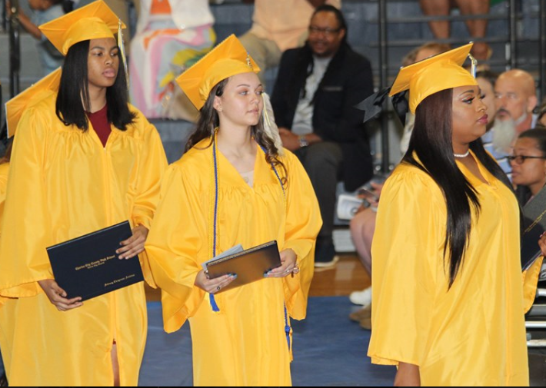
Slight Decline in 2019 Graduates Receiving Advanced Studies Diploma
One-third of CCPS graduating seniors exceeded the requirements for a standard diploma and earned either an Advanced Studies diploma or a Governor’s School diploma. Students (26.7%) earning an Advanced Studies diploma successfully completed a minimum of 16 classes (4 each) related to the four core content areas (English, History, Mathematics, Science) and at least three foreign language courses in the same language. In 2018-2019, three students (6.7%) were awarded a Governor’s School diploma which also exceeds the requirements for a standard diploma. The 2018-19 data establishes a baseline for students earning a Governor’s School diploma. The Performance Measure focuses only the graduates earning an advanced studies diploma, there was a 1.9 percentage-points from baseline decline in students earning this type of diploma in 2018-19.
Diploma Conferred on the Charles City High School Class of 2019
Diploma Type above Standard | Baseline (2017-2018) | 2018-2019
Advanced | 28.6% | 26.7%
Governor's School | Data unavailable | 6.7%
Educate Pillar Performance Measure 9: The percentage of graduates earning an advanced studies diploma. | Data Source Information: CCPS Central Office provided data (chart) that compared to the Virginia School Quality Report. Image Source: CCPS Facebook post (June 10, 2019)

Slide 21
More 8th Graders Earned High School Credit in 2018-2019 Than In Previous Year
In 2017-2018, 7% of 8th graders earned high school credit. This percentage greatly increased in 2018-2019 with 69% of 8th graders earning high school credit. A list of courses these students took include World History I, Algebra I, Spanish I & II, Technology Foundations, Office Specialist , and Art Foundations.
In 2018-2019, the technology foundations class was the most popular high school credit course taken by eighth graders.
Educate Pillar Performance Measure 10: The percentage of 8th grade students earning high school credit. | Data Source Information: CCPS Central Office provided the list of de-identified eighth grade students and the high school credit courses in which they were enrolled.
10

Slide 22
Percentage of Seniors with Postsecondary Study Plans Improves
The percentage of students attending or planning to attend career/technical or two-year schools increased from the prior year.
In 2018-2019, 62.22% of CCPS seniors had been accepted or planned to attend postsecondary school. This is an approximate 10 percentage-points increase from baseline. The number of students attending a four-year college decreased approximately 5 percentage-points in 2018-2019, but the number of students attending or planning to attend a two-year school increased in 2018-2019 by approximately 11 percentage-points. The percentage of students attending or planning to attend career/technical schools also increased in 2018-2019 by approximately 4 percentage-points.
Educate Pillar Performance Measure 11: The percentage of students accepted or intending to enroll in postsecondary study | Data Source Information: Baseline data was acquired from the Virginia Department of Education School Quality Profile. CCPS Central Office provided data from the 2018-2019 school year. Students (3) who attended the Governor’s School did not have secondary enrollment information available, therefore, data have the potential to change.
11

Slide 23
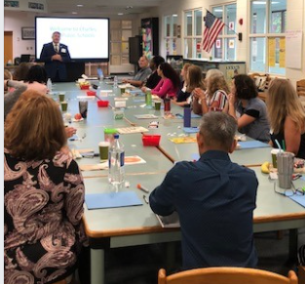
35% of Teachers are Satisfied with Professional Development Opportunities
Panorama’s professional learning survey collected teachers’ perceptions of the quality of professional growth and learning opportunities available to teachers. Items used to assess Performance Measure 13 were identified by the external evaluator. Teachers were asked to rate several items on a five-point scale. The five-point scale varied across the questions with the highest score being “extremely”, “tremendously,” and “almost all the time.” The next rating included “quite a bit” and “frequently.” The next ratings included, “somewhat,”
“some” and “sometimes.” The next ratings included, “slightly,” “a little bit,” and ”once in a while.” The lowest rating included, “”not at all,” ”Almost no,” and “Almost never.” Ratings of “extremely”, “tremendously,” “almost all the time,” “quite a bit” and “frequently” counted toward overall satisfaction.
Approximately 31 teacher surveys were completed indicating a 35% satisfaction with professional development opportunities. Thirty-nine percent of teachers found available professional development to be valuable. Thirty-nine
percent of teachers found available professional development to be valuable. Thirty-nine percent of teachers were satisfied with the amount of input they had on individualizing professional development. Thirty five percent of teachers were satisfied with professional development opportunities helping them explore new ideas. Finally, 29% of teachers felt satisfied with the relevance of professional development opportunities to the content they teach.
Educate Pillar Performance Measure 13: The percentage of certified staff reporting satisfaction with CCPS professional development opportunities. | Data Source Information: Data was provided by CPSS central office. The professional learning survey was deployed by the district using the Panorama Survey platform. This survey was a subcomponent of a larger Teacher Survey. The 2018-2019 data will serve as the baseline data for PM 13. The school system has begun using a point in time professional development feedback form to provide specific information about individual training sessions. Image Source: CCPS Facebook post (8/15/19).
13

Slide 24
Percent of Teachers Holding Advanced Degrees Declines in 2018-2019
In 2017-2018, 56% of certified staff had a Master’s degree. In 2018-2019 this number decreased 9 percentage-points.
In 2017-2018, none of the teachers had National Board Certification or dual enrollment certification. In 2018-2019, CCPS central office reported that one teacher had a National Board Certification, but no teachers had a dual enrollment certification. Other reflects teachers with other levels of educational attainment that do not align to either the advanced degrees (i.e., masters, doctoral) or bachelor degrees such as computer certifications.
Educate Pillar Performance Measure 14: The percentage of certified school staff with advanced degrees, National Board Certification, or dual enrollment certification. | Data Source Information: Data was extracted from the Virginia Department of Education School Quality Profile and CCPS central office.
14

Slide 25
83% of Teachers Report Feeling Confident in Engaging and Educating ALL Students
Considering Student Voice
It is worthwhile to examine whether students’ perceptions align with their teachers. Three items from the student climate survey were used.
Elementary students’ perceptions were similar to the teachers, indicating they feel supported 81% of the time. However, secondary students perceived their teachers were supportive 38% of the time.
Items from the Student Surveys | Elementary | High School
How much do your teachers encourage you to do your best? | 80% | 36%
Overall, how high are your teachers' expectations of you? | 82% | 39%
When you feel like giving up on a difficult task, how likely is it that your teachers will make you keep trying? | 82% | 37%
Elementary and secondary teachers feel as though they are effective at engaging and educating all students
Teacher efficacy can be a predictor of student success. When teachers are confident in their abilities, they are more likely to use their skills and abilities to support student learning than teachers who are not confident.
Research abounds about the impact of the student teacher relationship on student outcomes. Students will work harder for teachers who they believe are invested in them. Secondary teachers may benefit from as formative feedback from students that can be gained through a short anonymous survey that the teacher distributes, collects, and analyses. The Virginia Department of Education has four student surveys (see note below).
Educate Pillar Performance Measure 15: The percentage of teachers reporting confidence in engaging and educating all students | Data Source Information: Panorama CCPS Teacher Climate Survey administered in Spring 2019. NOTE: Panorama Survey calculated the 83%, unable to disaggregate by school level. The external evaluator also examined the students’ perceptions of the support they receive from their teachers which were collected the Panorama Student Climate Survey for Grades 3-6 and Grades 7-12. Reference: Uniform Performance Guidelines has surveys on pages 23-27 located at http://www.doe.virginia.gov/teaching/performance_evaluation/teacher/index.shtml

Slide 26
Engage
Grow stakeholder interaction in the educational process through focused collaboration and effective communication.

Slide 27
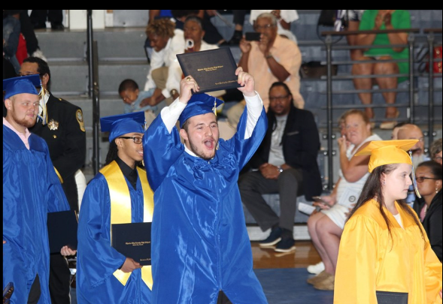
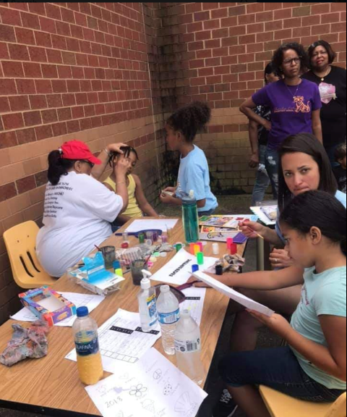
37% of Families are Satisfied with Their Children’s Schools
Ninety-seven families responded to the 2019 Panorama Family Climate Survey. The Family Survey queried respondents on five subscales: barriers to engagement, family engagement, family support, school climate, and school fit. Three items within these subscales most closely aligned to the construct of “satisfaction.” They are: How well do the activities offered at your child’s school match his/her interests? To what extent do you think that children enjoy going to your child's school? How motivating are the classroom lessons at your child's school? Thirty-seven percent of respondents rated these items as “extremely well” or “quite” which were interpreted to mean they were satisfied.
Two of the items appeared in the previous 2018 Family Climate Survey. So an overall comparison was not calculated. In general, families thought that their children enjoyed going to school less in 2019 than in 2018. Families reported more satisfaction in 2019 with how motivating classroom lessons were than in 2018.
Engage Pillar Performance Measure 17: The percentage of families expressing satisfaction with events, programs, and resources provided by schools or the division. | Data Source Information: Panorama CCPS Family Climate Survey administered in Spring 2019. As not all items on the 2019 survey were also on the 2018 Panorama CCPS Family Climate Survey , the external evaluator is only providing directionality of the change.

Slide 28
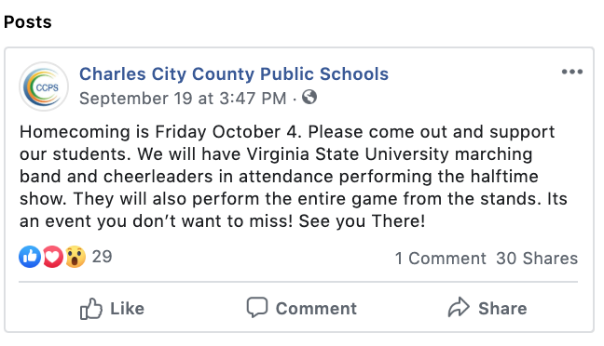
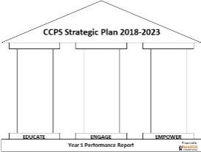
Charles City Public Schools Social Media Accounts
A baseline analysis of Facebook data took a three pronged approach to include: 1) Likes, 2) Engagement, and 3) Media. Likes include the number of unique users who “selected” like on the district’s Facebook Page. Engagement includes the number of unique users who engaged with the Page. According to Facebook, engagement includes any click or story created. Media analysis included average number of photos viewed and average number of videos viewed.
It is beneficial to examine the engagement trend from Aug. 2018 to June 2019 to identify what appeals to stakeholders. This metric highlights individuals who interacted with the page, including clicking on stories, commenting, and replying to the content within the page. Overall, individuals interacted with the page more in the fall semester than the spring.
Facebook Likes ranged from 43 (August) to 3 (May) “Likes” during the school year from unique Facebook users. In total, these users clicked “Likes” 747 times.
747
From 2018-2019 a steady stream of traffic visited Charles City Public School’s Facebook Page.
Social Media Accounts analysis considered the division’s Facebook account (started March 2015); data from the division’s Twitter account, which was launched in May 2019, was not analyzed since it was not active during the majority of the school year. As of October 8, 2019, the division’s Facebook account had 836 followers.
Increasing engagement can be accomplished by sharing CCPS’ Facebook page using a QR code at any schoolwide event including Open House and Back to School Night. It is also suggested that a link to the Facebook page be included in administrators’ e-mail signatures by linking the Facebook logo and Twitter accounts.
The peak in engagement coincides with the start of the school (1,328) and a second peak occurs in June around graduation.
Engage Pillar Performance Measure 18: Number of stakeholder responses posted on division social media accounts. | Data Source Information: Follower information was procured from the publicly accessible account homepages. Facebook analytics data was provided by CCPS central office.
18

Slide 29
74% Stakeholder Communication Satisfaction
Thirty one teachers expressed a 57% communication satisfaction. Coincidentally, the response rate was also 57%. Most teachers (83%) were confident that they could communicate with an upset parent. Yet 47% of teachers perceive that families act in a caring way towards them. Finally, 52% of teachers perceive that school leadership communicates effectively with them.
Less than half of the 15 responding staff members (48%) are satisfied with communication within the school division. Thirty-eight percent of staff members perceive that the families of the students care about them and 14% find it challenging to communicate with families. Most staff members (87%) perceive that school leaders communicate effectively with them.
Panorama’s school climate surveys collected family, staff, and teacher communication perceptions through items identified by the external evaluator. Staff and family survey respondents rated several items as “not a problem,” “a little problem,” “medium problem,” “large problem,” or “very large problem.” Ratings of “not a problem” or “a little problem” counted toward overall satisfaction. The teacher survey also used a similar five-level feedback
Ninety-five family surveys were completed indicating an 85% satisfaction with home-school communication. Twenty-two percent of responding families would like more information about how to become involved in school. Over half of families (62%) believe that parents are principally responsible for ensuring good communication between home and school. Nearly all respondents (95%) perceive that the school communicates effectively with their culture.
A 2019-2020 opportunity is to add items to the Panorama Student Surveys to collect students’ perceptions on communications.
Engage Pillar Performance Measure 19: The percentage of staff, community, parents, and students reporting satisfaction with school and division communications | Data Source Information: Data was Panorama Survey, a vendor contracted by CCPS.
19

Slide 30
Empower
Enable stakeholders to understand their vital role in the success of the school division by leveraging their position as esteemed members of the educational community.

Slide 31
Teachers are Active Participants on School Committees
Elementary School
Math Committee
Literacy Committee
Attendance Committee
School Events Committee
Student Spirit Activities Committee
Senior Activities Committee
Parent Night Committee
School Programs Committee
At the elementary school and high school 48 potentially duplicated teachers are participants on 8 school-wide committees.
There is potential for the data for performance measure 20 to be more accurate. For example, providing the names of teachers participating on each committee would enable a percentage of teachers participating in school or division committees to be calculated.
Legend
= 1 Teacher
Empower Pillar Performance Measure 20: The percentage of teachers participating in school or division committees to provide teacher input and voice | Data Source Information: Data was provided by CCPS central office. Only teacher numbers and names of committee were provided, therefore, these numbers could include duplicated teachers.
20

Slide 32
Decline in Percentage High School Students Engaged in Leadership
High school students lead their peers. Some students each year affiliate with multiple school groups developing their leadership capacity. The Charles City High Yearbooks recognized leadership in the following areas. Band Future Business Leaders of America Junior Reserves Officer Training Corps (JROTC) National Honor Society
The stacked bar chart shows the total number of leadership opportunities documented in the Charles City County High School Yearbook. The blue bar indicates student leaders who engaged in multiple leadership opportunities. The number in the orange bar indicates the number of student leaders for a particular school year.
It is recommended that future yearbooks acknowledge student leaders by placing their role (e.g., captain, treasurer) in parentheses next to their name in club, band, and team images.
Empower Pillar Performance Measure 21: The percentage of high school students engaged leadership-focused activities. | Data Source Information: Charles City County Public School did not previously collect student leadership information. For the baseline data, the 2017-2018 yearbook was used. For the current year's data the 2018-2019 yearbook was reviewed. Due to the absence of identification of team captains, band majors. principal student advisory council, PTSA representatives, etc. Counts of students in clubs whose descriptions included the words "leadership" or" developing leaders" were used. The JROTC pages did not list student
21

Slide 33
Next Steps
A strategic plan occurs over time to develop the organization from where we are to where we want to be to achieve our goals together.

Slide 34
Need for Improvement in Data Collection
The CCPS Strategic Plan provides guidance through 2023 as stakeholders navigate the education environment. When the Plan was written in 2017-2018, it envisioned where the Charles City County Public Schools would be in 2023. The pillars organize the objectives and the performance measures (PM) support leadership and others in making strategic decisions to stay-the-course, modify actions, or even make a change.
The Year 1 report (2018-19) contains more data and information than was previously available during the baseline year (2017-2018). There are performance measures where the data was not available or insufficient. These are opportunities for data collection in Years 2 and beyond. CCPS Leadership began addressing some these in Year 1 and will continue to do so in Year 2 as the Strategic Plan is phased in. The data collected and analyzed in 2019-2020 will be established as the baseline for the performance measures listed below.
Educate
Performance Measure 2: The percentage of classroom lessons that include instructional technology tools and resources.
Performance Measure 7: The percentage of classroom lessons that include problem-based instruction.
CCPS principals and district leadership developed a classroom walkthrough tool (on next page) in Summer 2019 that will be implemented in the 2019-2020 school year to provide feedback to teachers and collect this data.
Performance Measure 6: The percentage of teachers participating in vertical teaming opportunities.
SEG recommends documenting with sign in sheets professional development sessions with vertical teaming opportunities.
Performance Measure 12: The percentage of students engaged in college and career readiness planning.
SEG recommends that the high school counselor electronically provide documentation related to CCR planning.to the principal (e.g., logbook, agenda, list
Engage
Performance Measure 16: The number of participating community partners and volunteers at school and division events.
CCPS began maintaining the data records with Open House (8/28/19, see image of a sheet that teachers used to document participation). Previously visitors signed in at the office; however, those sheets were not filed for annual review. CCPS applied for a grant to get computer software that allows visitors to sign in electronically, notification of the grant status has not been received.
Empower
PM 22: The percentage of school committees/advisory boards that include diverse stakeholder groups.
SEG recommends that two data points need to be developed.
List of ongoing school committees and school /district advisory boards with rosters
Checklist that aligns to the CCPS Guidance on committee membership
of sessions conducted and indicate how many students in the case of a whole class/group activity) by the last day of school.

Slide 35
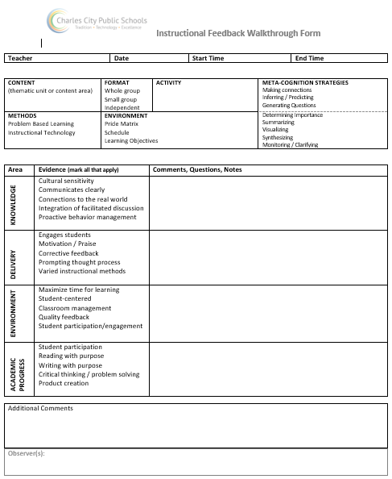
The Instructional Feedback Walkthrough Form Now Collects Methods Information
To capture the percentage of technological tools and resources that are being used (performance measure 2) and the frequency of problem-based learning classroom lessons, CCPS developed a walkthrough observation protocol this summer (See Right Image). This form will capture a snapshot of what is occurring in classrooms. Beginning fall 2019, administrators will pilot the form and then collect baseline data in the spring 2020 observation cycle.
Educate Pillar Performance Measure 2: The percentage of classroom lessons that include instructional technology tools and resources. Performance Measure 7: The percentage of classroom lessons that include problem-based instruction | Data Source Information: CCPS Central Office provided the observation tool developed for this performance measure. Baseline data will be established 2019-2020.
2
Notes:
Dave and Todd, what is the plan for the walkthrough form. Is it part of the formative/informal observations for the teacher evaluation system (so it can do double duty)? How often will it be used. I made up the last sentence based on what I guessed would occur. What have you actually planned? Has a version of this form previously been used (it has hallmarks of other things I have used/seen)? What training or interrater reliability observations is planned/anticipated?

Slide 36
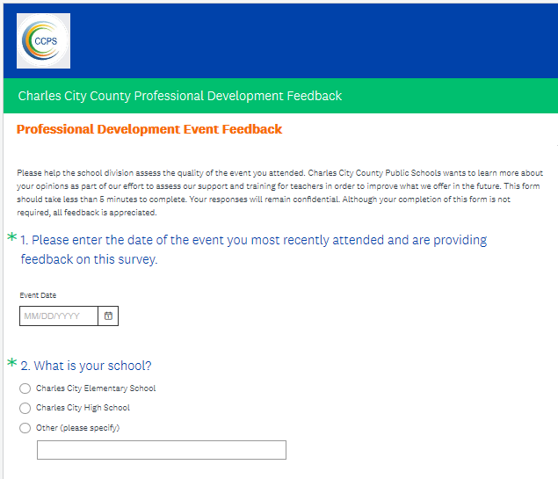
CCPS Leaders and Teacher Leaders Receive Professional Development Feedback from Colleagues
Since implementing in late August 2019, 108 surveys have been completed after multiple professional development events. Thus far, the overall satisfaction rating is 75%.
Performance Measure 13 documents overall teacher satisfaction with professional development opportunities. The data came from the annual school division climate survey as no point-of-service document existed. In Collaboration with SEG, CCPS created a professional development feedback form for participants to take online after attending professional development opportunities. This information can be used to monitor the implementation of the strategic plan as well as provide specific feedback to the training facilitators (see form above). The survey takes three minutes or less to complete and collects participants’ ratings of the professional development, training facilitators’ effectiveness, and relevance. Also, there are open-ended fields to identify strengths and opportunities for improvement .
Educate Pillar Performance Measure 13: The percentage of certified staff reporting satisfaction with CCPS professional development opportunities. | Data Source Information: SEG Survey Monkey
2
Notes:
Dave and Todd, what is the plan for the walkthrough form. Is it part of the formative/informal observations for the teacher evaluation system (so it can do double duty)? How often will it be used. I made up the last sentence based on what I guessed would occur. What have you actually planned? Has a version of this form previously been used (it has hallmarks of other things I have used/seen)? What training or interrater reliability observations is planned/anticipated?

Slide 37
Looking Towards Year 2
The burden of data collection and submission for the baseline data and Year 1 data was borne by the Assistant Superintendent. SEG recommends that in Year 2, the assistant superintendent, if he remains the point of contact (POC), distribute the data collection and maintenance responsibilities to the appropriate CCPS employees who would submit the documentation to the POC. Recommended items to delegate the collection of performance measures appear in the table. Suggested due dates are provided Items are to be submitted electronically by CCPS to the SEG Dropbox.
Sharing the responsibility for data collection and review increases investment and ownership of the CCPS Strategic Plan.
Item (Pillar, Performance Measure Number) | Suggested Responsible Person (via if applicable) | Suggested Date Due to the CCPS POC
Enrollment information: Flexible learning and dual enrollment information (Educate, 1); CTE credentials earned (Educate, 5); Students taking college level courses (Educate, 8) 8th graders taking high school courses (Educate, 10) | School Counselor (via School Principal) | First business day after the last day of school
Walk-through data (Educate, 2, 7) | School Principal | Quarterly
Vertical teaming opportunities records (e.g., professional development agenda, participant roster) (Educate, 6) | School Principal | First business day after the last day of school
Post-secondary plans record (Educate 11); Record of college and career planning activities and number of students served in which grades (e.g., logbook) (Educate, 12) | School Counselor (via School Principal) | First business day after the last day of school
Volunteer, Parent, and Community Sign-in Sheets (PDF) or export of a computer file in Excel (Engage, 16) | School Secretary (via School Principal) | End of each semester and last day in August
Facebook analytics export (Engage, 18) | Instructional Technology | First business day after the last day of school
Yearbook club pages (PDF), high school only (Empower, 21) | Yearbook Advisor (via School Principal) | First business day after the last day of school
Committee and Advisory Board Rosters and composition (Empower, 20, 22) | Committee Chairs (via School Principal, if a school-based) | End of first semester
Notes:
Dave and Todd, this is a new slide. As you may recall we sent the initial rough draft missing a few slides.
I saw a Facebook post for recruiting volunteers. Will the schools be tracking the hours that the volunteers contribute? I listed the school secretary as a person who could supply the information, but perhaps there is someone else in the division who would be better.

